Slide 1
CZ1015
AirBnb Open Data from Seattle
Marcus Foo
Ian Pang
Jovan
Ray

Slide 2
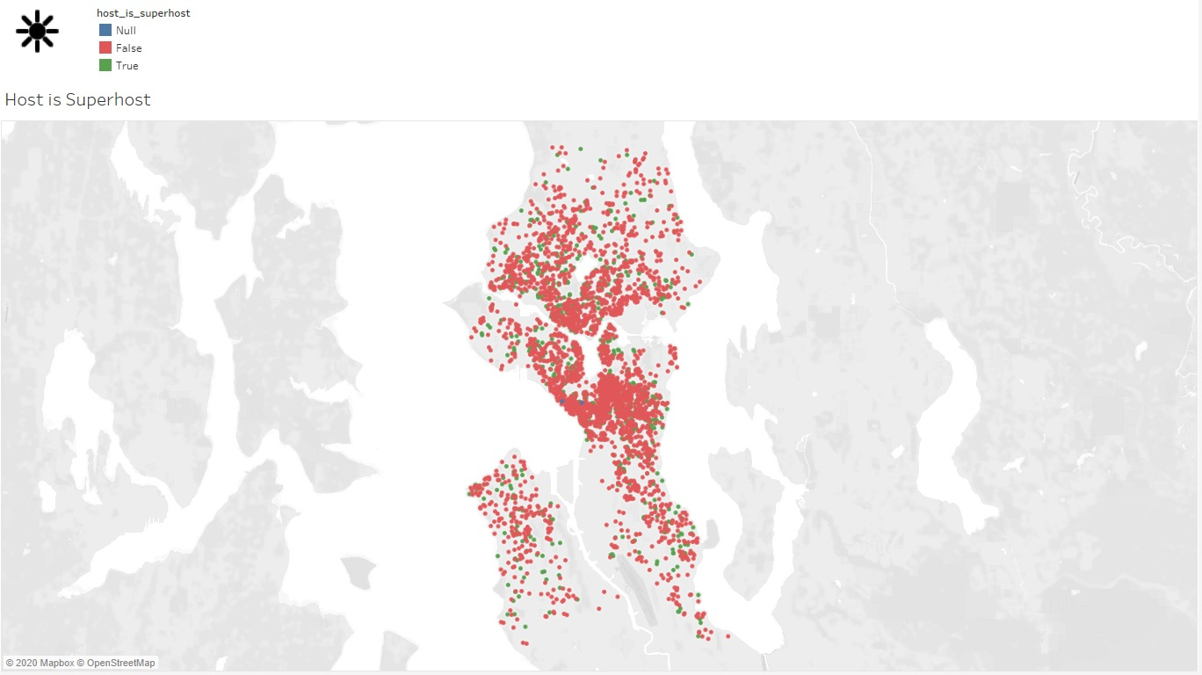
Problem formulation
Tableau dashboard map of superhosts

Slide 3
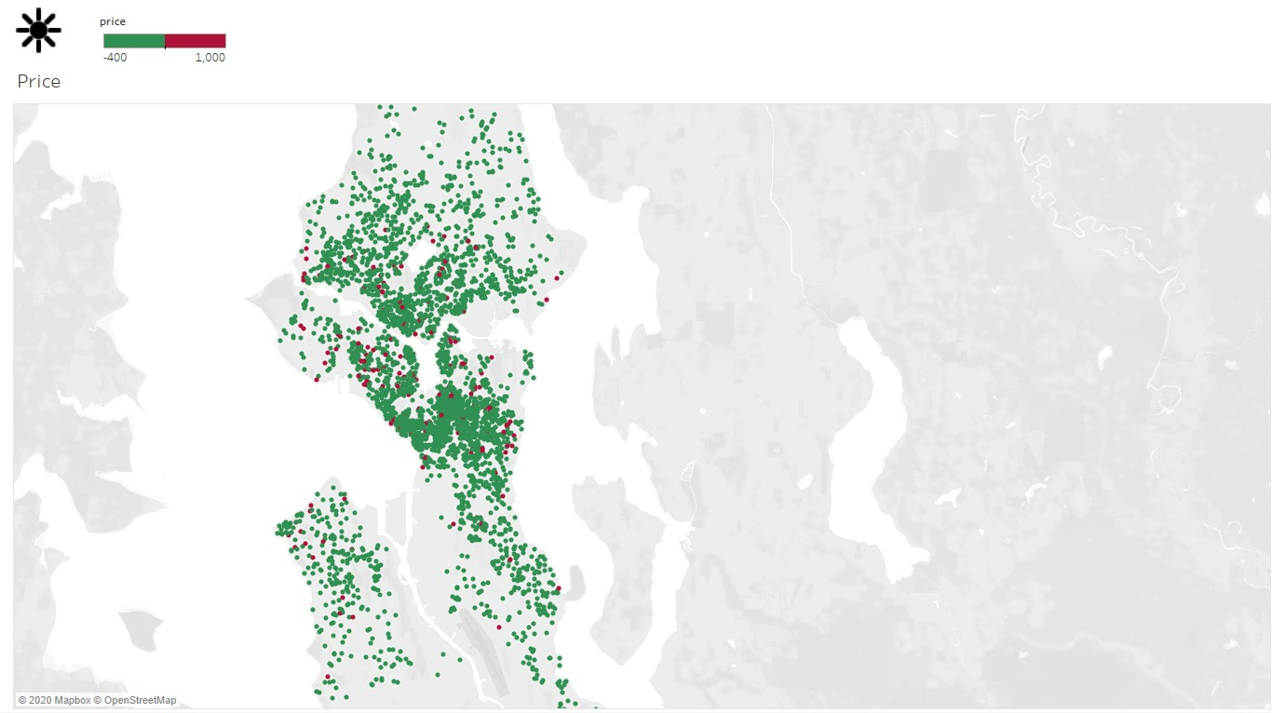
Problem formulation
150
Tableau dashboard map of price

Slide 4
Problem
Main Problem:
What makes an Airbnb listing worth it?
Secondary problems:
What features apart from price and reviews make an apartment "worth it" ?
How can we quantify "worth" in an accurate manner ?
Can we determine if a listing is "worth it" without looking at price ?
Does the presence of certain amenities correlate with review scores?
Notes:
We therefore decided to tackle this dataset from the consumers’ point of view.
more focus on what features are more important

Slide 5
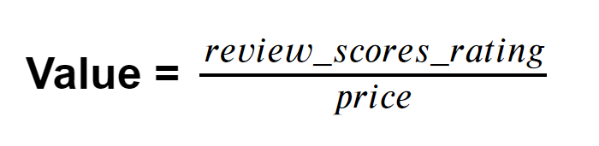
Our approach
Whether a listing is “worth it” is determined using a new feature: “value”
We defined “value” as:
Notes:
So how do we know whether a listing is so-called “worth it”?. For that, we decided to represent it using a new feature called “value”. After looking through the variables in the dataset, we found that it made sense to use 2 variables: review scores rating and price. Therefore our definition of value is represented by the following equation: review scores rating divided by price.

Slide 6
Initial preparation of dataset
Data formatting
Convert dates to datetime format
Remove ‘$’ and ‘,’ from price features and convert them to float
Convert percentage based features to float
Convert true/false features to boolean format
Remove rows that do not have review data
Process features into readable inputs
Convert "last_scraped" date to the number of months since last scraped
One-hot encode "host_verifications" and "amenities" into a group of binary features
Classify dates in "calendar_updated" into more generic categories

Slide 7
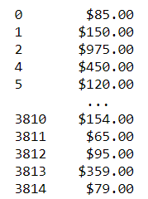
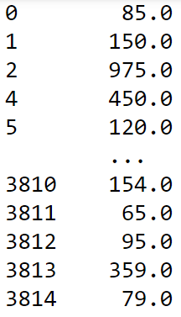
Data formatting
Formatting of “price” column

Slide 8
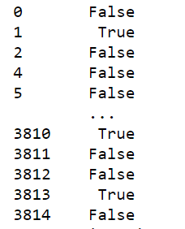
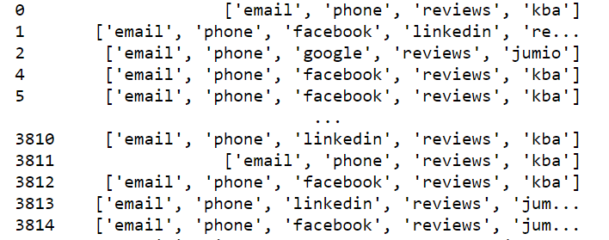
Processing of features into readable inputs
Original “host_verifications” column
New “*linkedin” column

Slide 9
Further Data Wrangling
Data Imputation
Used feature’s median values to fill null values
Feature Selection
Excluded data IDs and URLs

Slide 10
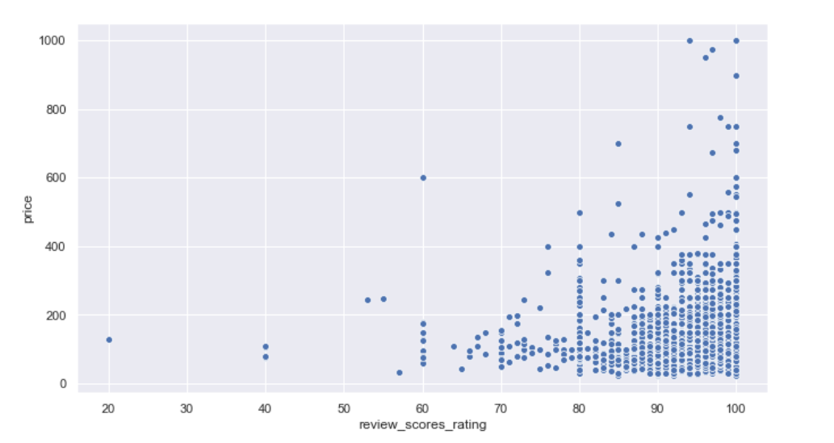
Visualization of data
Scatterplot of price vs review_scores_rating
Notes:
As we are using the variables “review_scores_rating” and “price”, we first generated a scatterplot of price vs review scores rating. Seeing this scatterplot, we noticed that the data points tend to cluster around high review scores ratings and lower price.

Slide 11
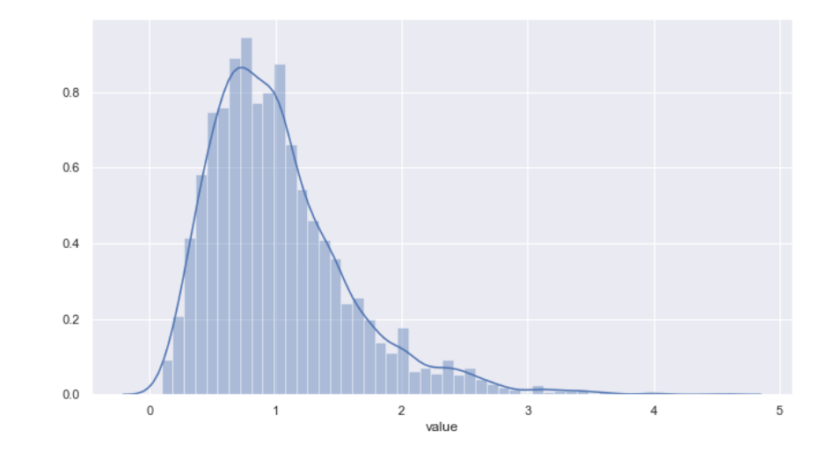
Visualization of data
Skewed towards lower values
Distribution plot of “value”
Notes:
We can see from the distribution plot that the data is skewed towards lower values. This suggests that outliers will tend to those of higher value.

Slide 12
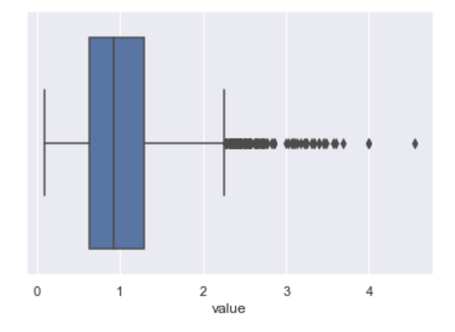
Visualization of data
Box plot of “value”

Slide 13
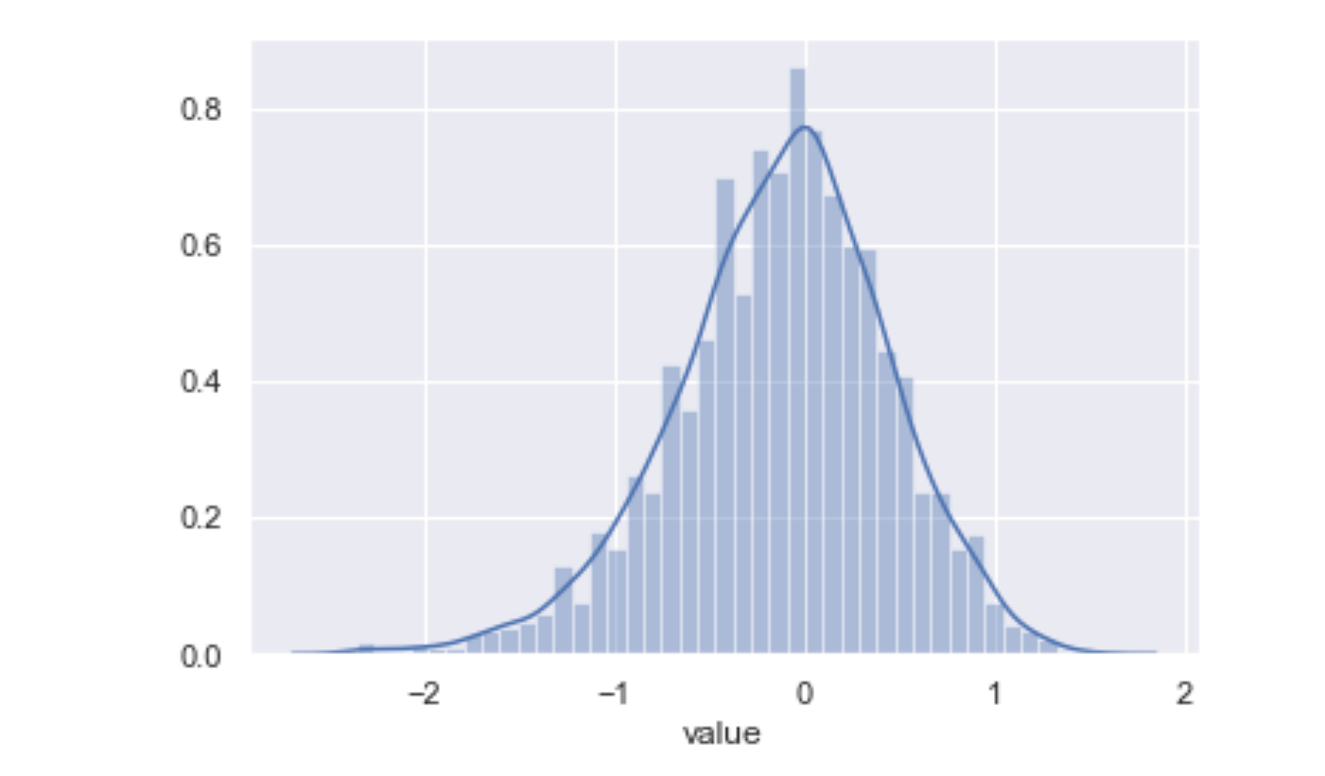
Visualization of data
Distribution plot of log-transformed “value”
Notes:
What was interesting is that we found that after we log transformed the graph, it looked similar to a normal distribution

Slide 14
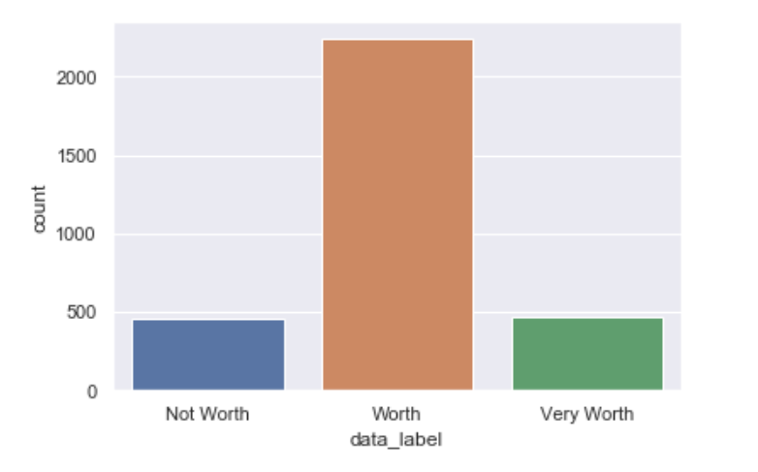
Visualization of data
70%
15%
15%
Notes:
We decided to partition the data into 3 categories: not worth, worth, and very worth. Listings that are of values below the 15 percentile are classified as “not worth”, while listings above 85 percentile are classified as “very worth”. The remaining listings were classified under “worth”.

Slide 15
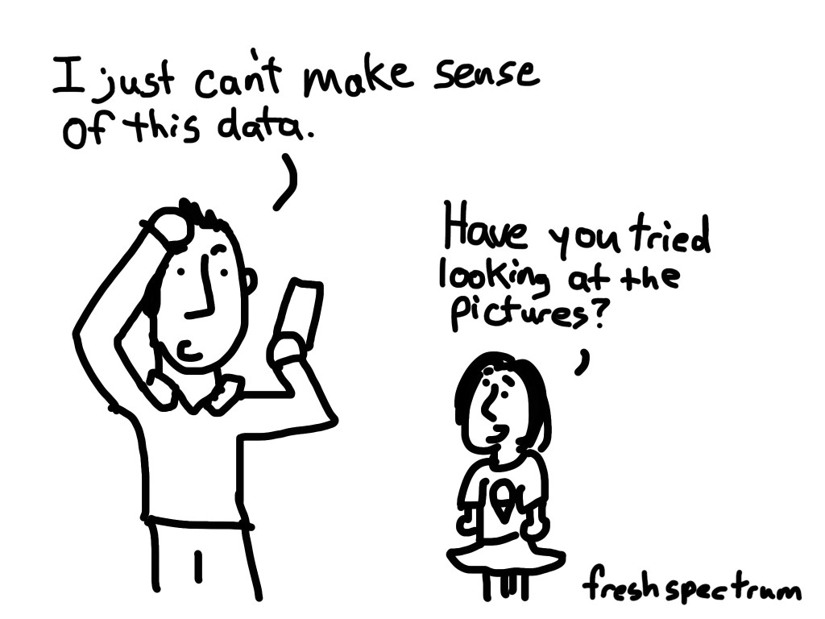
Exploratory Data Analysis (EDA)
Review Score’s Analysis
Neighbourhood Analysis
Host Analysis
Listing Property Analysis
Notes:
Thank you Ian. For our EDA, we analysed the review score, neighbourhoods, host and listing property.

Slide 16
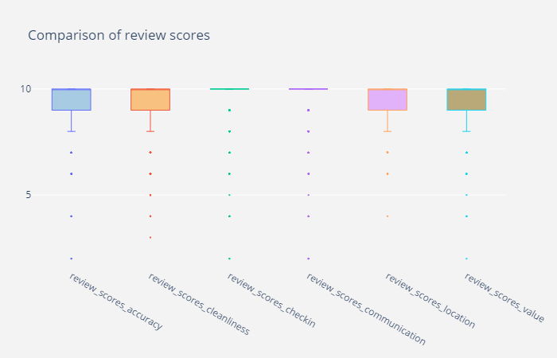
Review Score’s Analysis - Boxplot
Boxplots of 6 different components of review_score_rating:
Generally:
Skewed towards 10
Minimal outliers
Notes:
Looking at the different components of the reviews scores, we can see that all are biased towards 10.

Slide 17
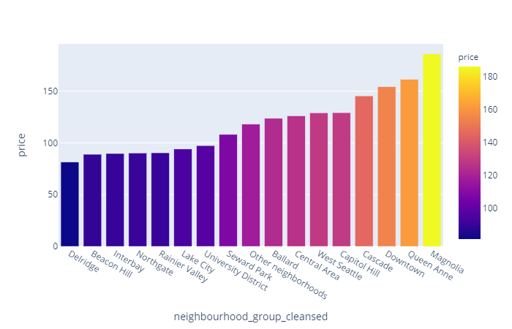
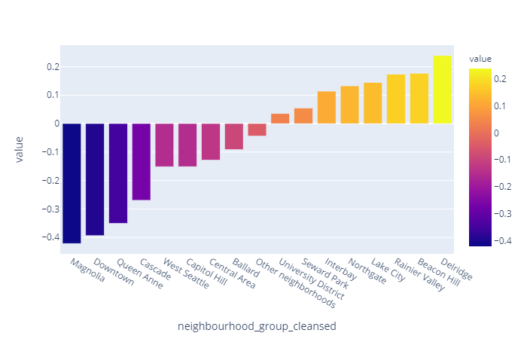
2) Neighbourhood Analysis - Bar graph
Comparison of prices across neighbourhood
Comparison of value across neighbourhood
Neighbourhoods with high prices have a very low value score.
Notes:
Moving on to Neighbourhood Analysis, we can see the comparison of prices across neighbourhood on the left and the comparison of value across neighbourhood on the right.
We can see that Magnolia’s listings have a high price but low value which is expected because of our formula for value.

Slide 18
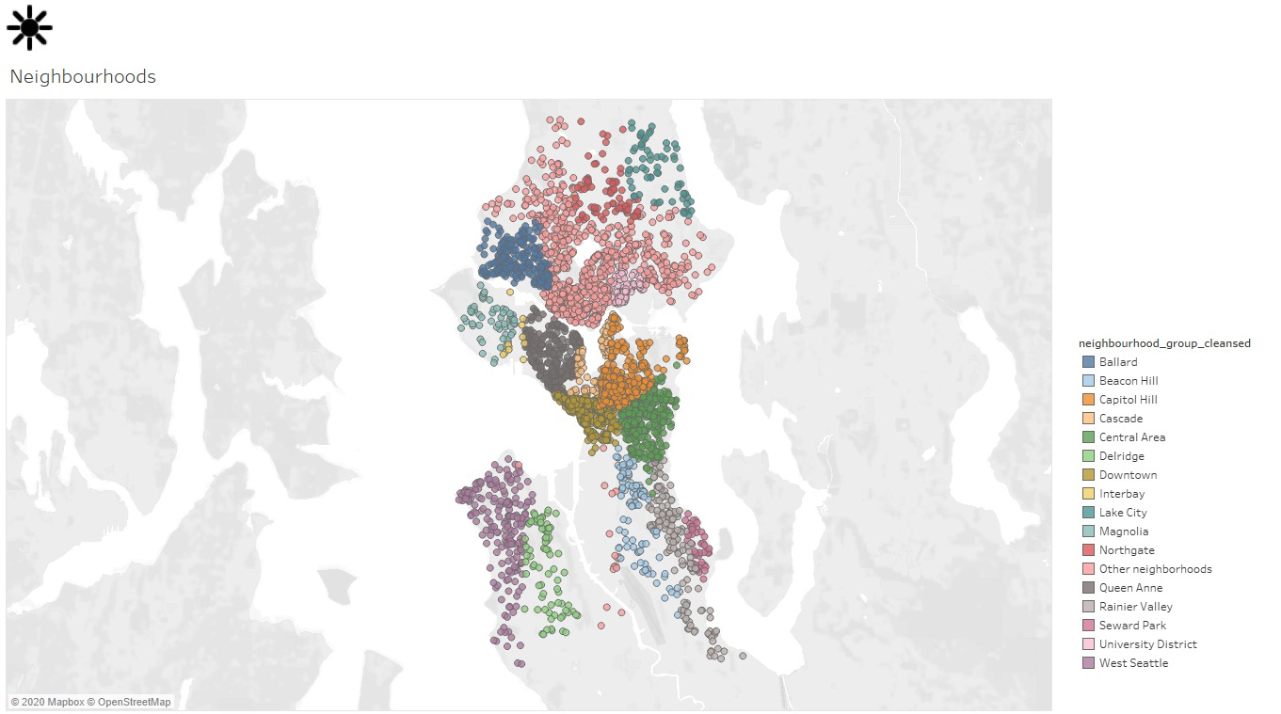
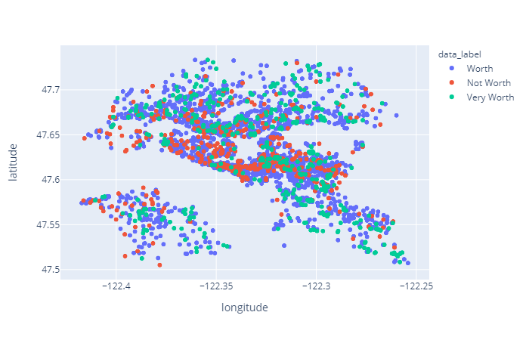
2) Neighbourhood Analysis - Scatter Graph
Overall distribution of listings across Seattle
Notes:
Here, on the left, it shows whether a listing is “Very Worth”, “Worth” or “Not Worth” on a map.
On the right, it shows listings grouped by their neighbourhoods.
We can see that locations like Beacon Hills have alot of “Very Worth” listings.
It is very close to CBD area like Downtown. Areas outside but near the CBD area might yield high value.

Slide 19
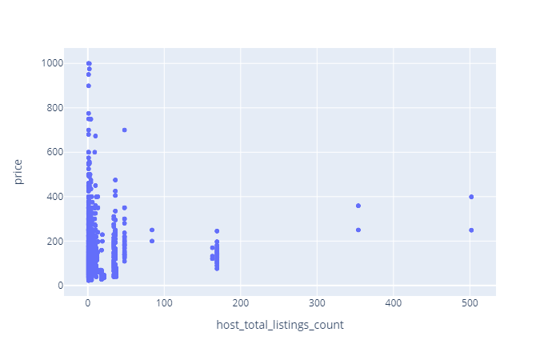
3) Host Analysis - Scatter Graph
High number of Listings
Able to provide apartments at cheaper rates due to economies of scale
Notes:
In our host analysis, we expected hosts with more listings to provide apartments at cheaper rates due to economies of scale.
However, we can see that listings that are less than $200 are from hosts with less than 200 listings.

Slide 20
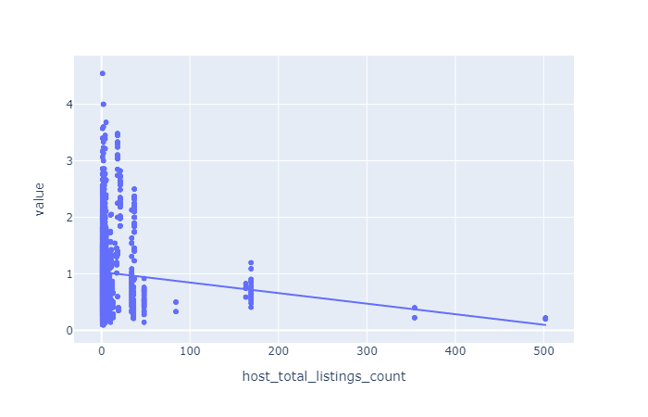
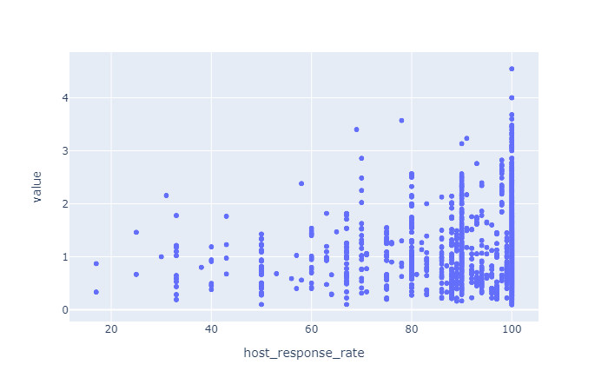
3) Host Analysis - Scatter Graph
Value against Host_total_listings_count
Value against Host_response_rate
Notes:
Here are the graphs of value against host_total_listings_count and host_response_rate. On the left, we can see that the value is evenly distributed when listing counts is low. However, value decreases as listing count increases.
On the right, values are evenly distributed when response rate is high. However, low response rate generally have low values.

Slide 21
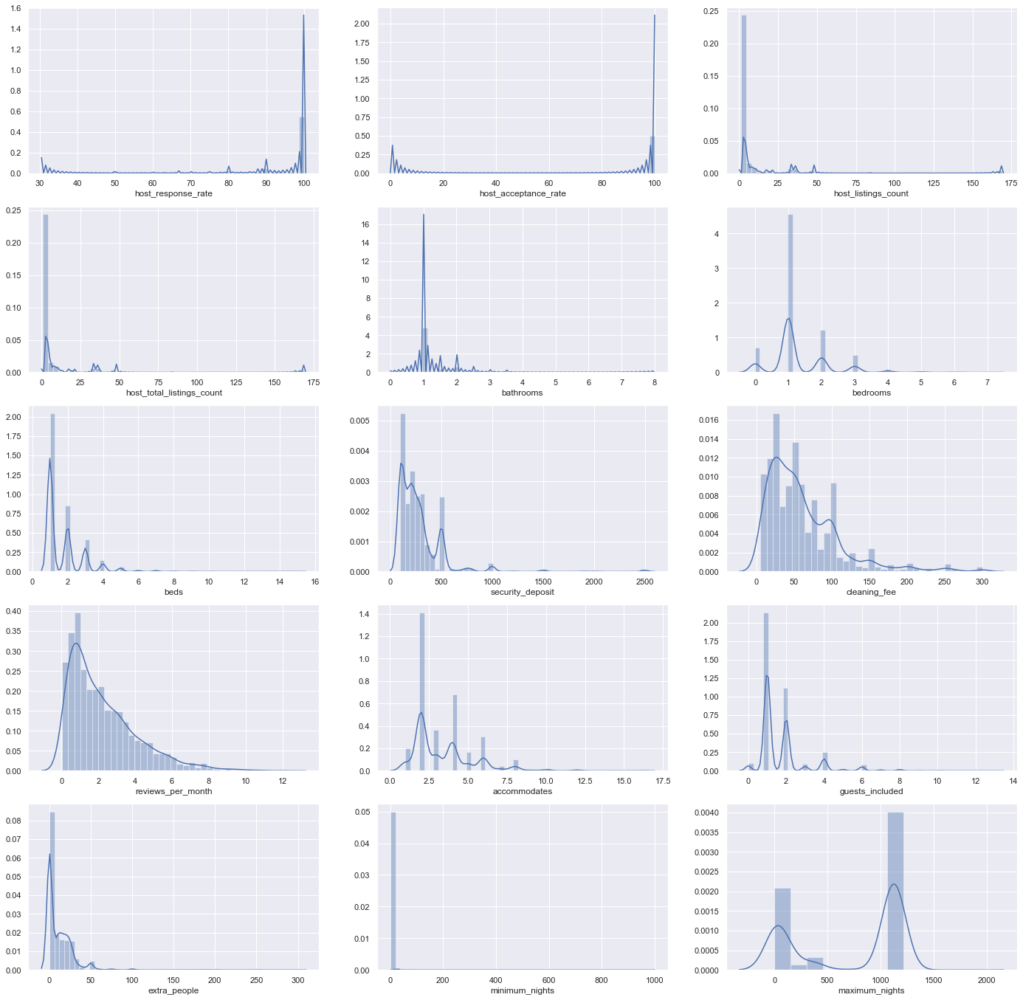
4) Listing Property Analysis
Notes:
In our property analysis, for each features, we try to look for outliers and skewness. Most are skewed which could be due to the small dataset.

Slide 22
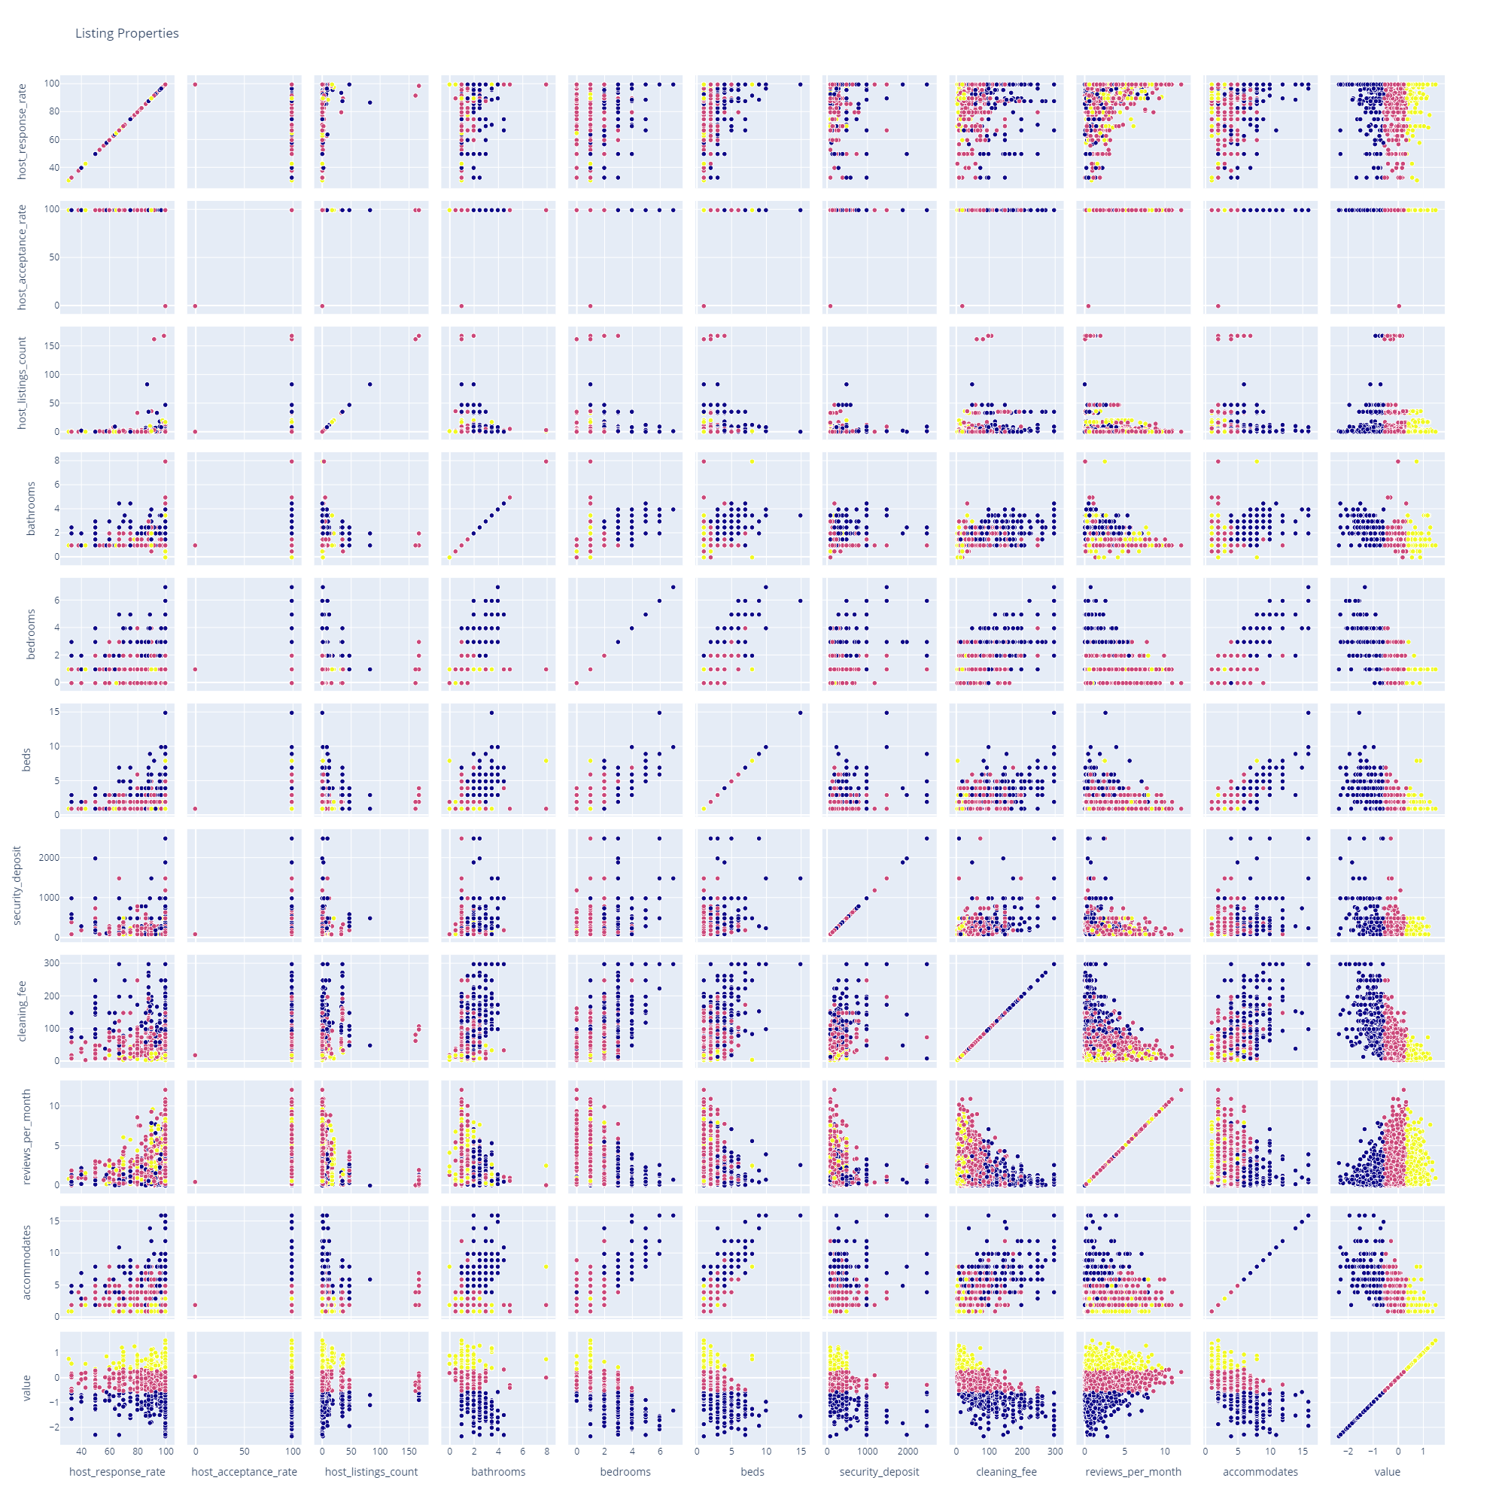
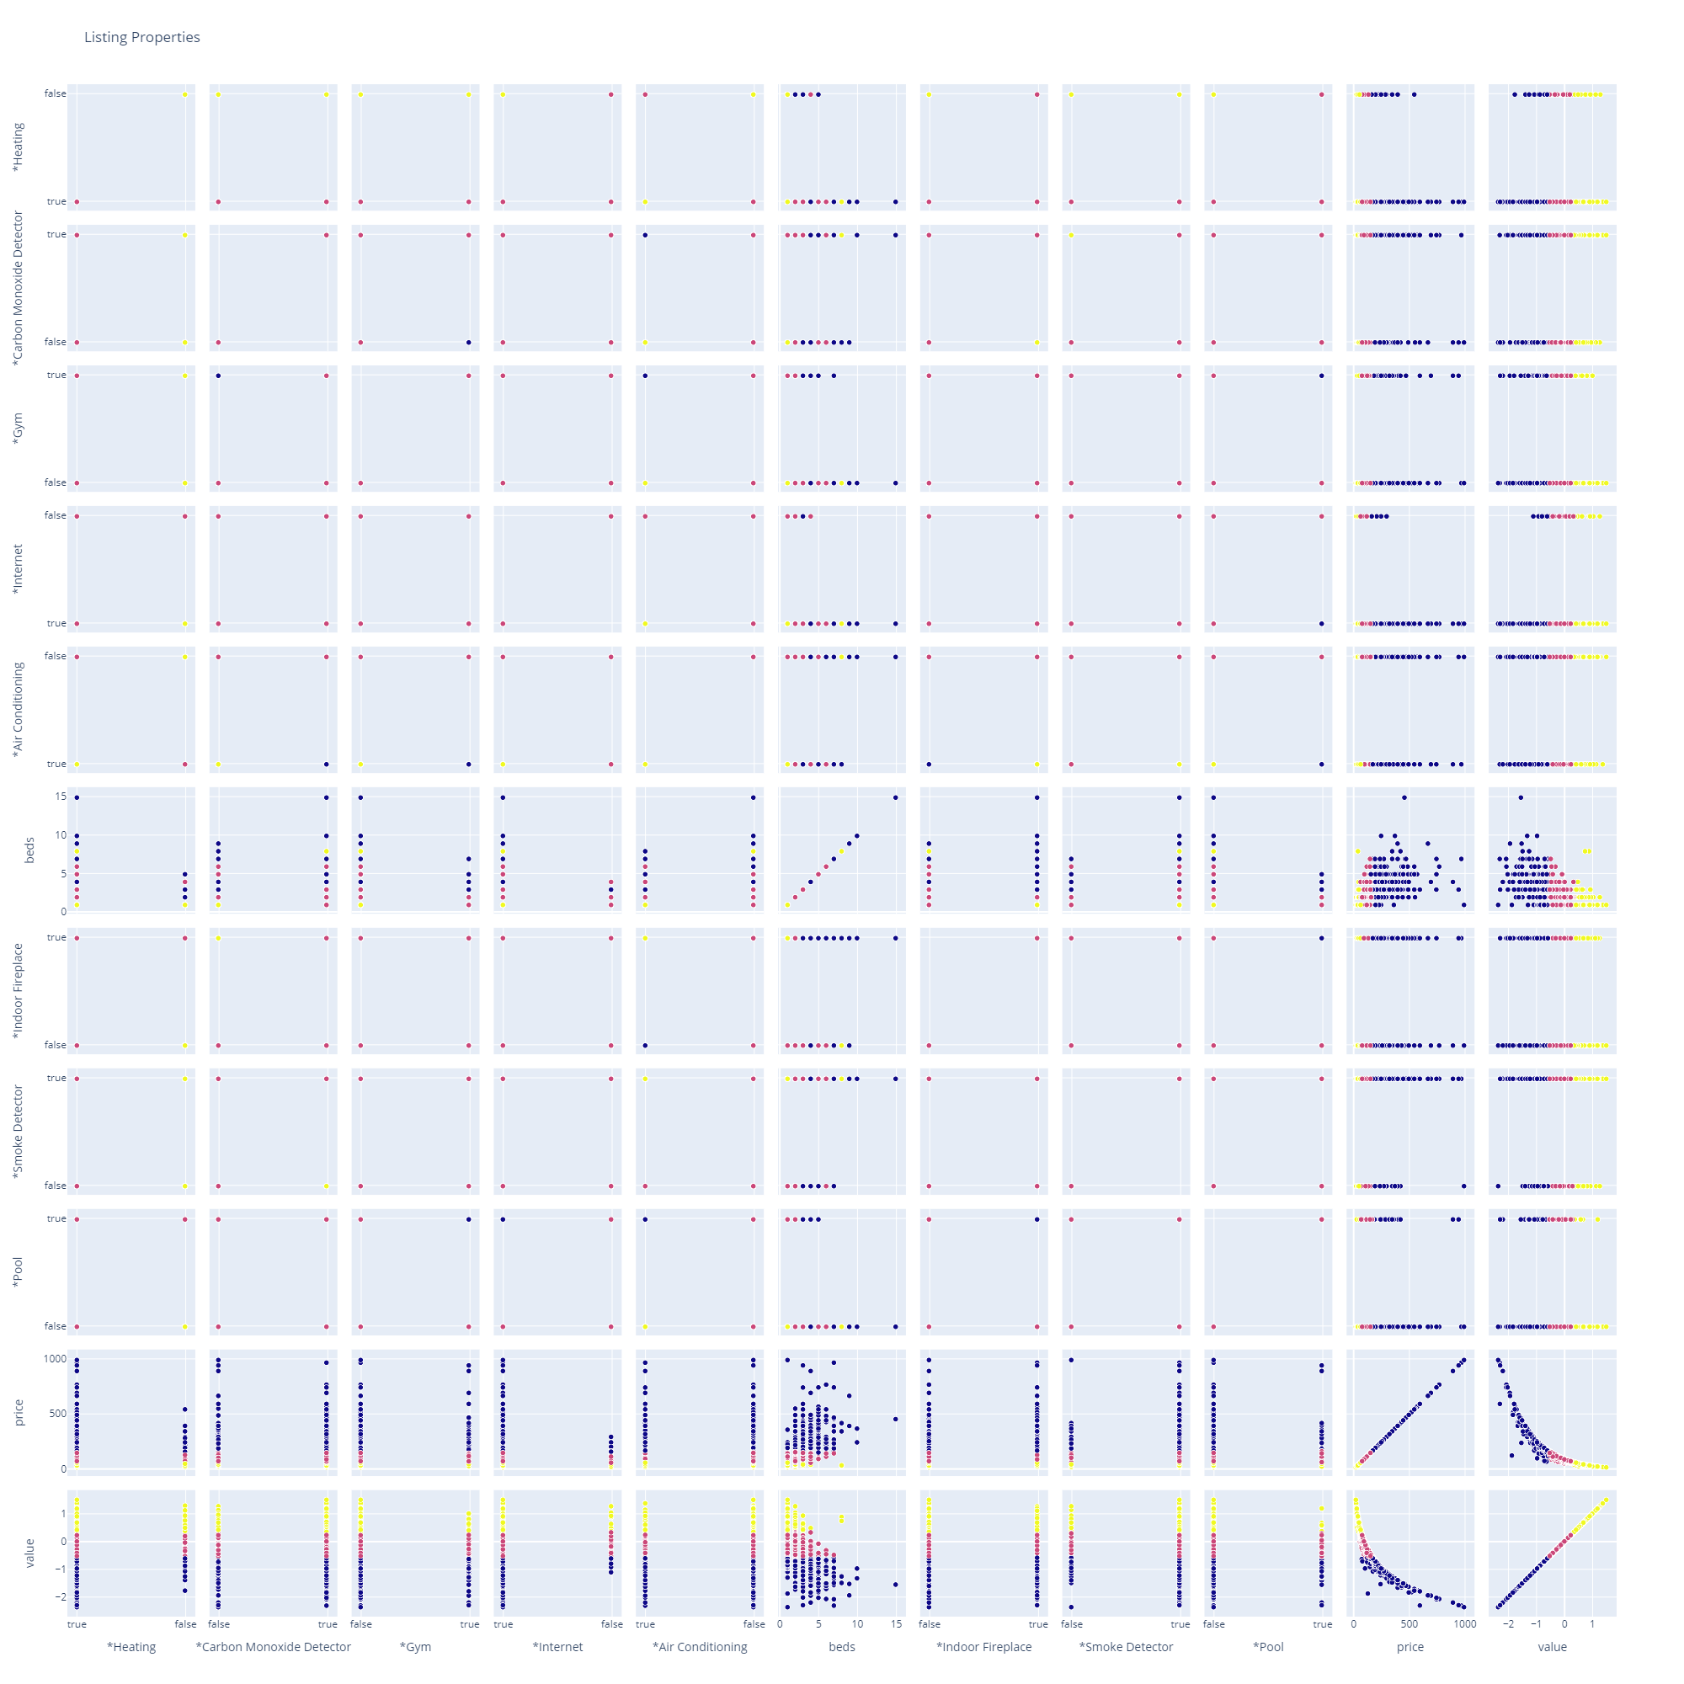
4) Listing Property Analysis
Legends:
: Very Worth
: Worth
: Not Worth
Notes:
By exploring further, we can see that
“Very worth” cluster around areas where there are no fees or little facilities and “Not worth” cluster around areas with high fees or many facilities.
For acceptance rates, we will remove one outlier which is 0.
However, for response rate, a low rate may not mean much because listings are generally informative enough for tenants so hosts may not be active on answering requests.

Slide 23

Feature Engineering
Continuous Features:
host_response_rate x host_acceptance_rate: Host acceptance frequency
number_of_reviews x host_listings_count: Review frequency of host listing
cleaning_fee x security_deposit: Fee charge
reviews_per_month / number_of_reviews: Gives weights to recent listings and reviews
Discrete features
Kitchen x Hot Tub
Kitchen x Gym
Gym x Hot Tub
Air Conditioning x Heating
Pool x Hot Tub
Notes:
Afterwards, we did more data preparation like feature crossing, which is the multiplication of 2 or more features to capture a joint relation.
For continuous features, feature crossing gives us:
host acceptance frequency,
review frequency of host listing,
fee charge,
and weights to recent listings and reviews
We also went on to feature cross discrete features which gives us better overall facilities.

Slide 24
Assumption and Biases
Assumptions:
The concept of value can be assessed by considering only price and review ratings.
The distribution from the dataset is representative of the population.
Listings are informative enough.
Biases:
Features like room types and fees drive prices up.
Certain neighbourhoods have higher natural prices.
Components of reviews score are biased, causing the rating scores to be biased.
Notes:
Before we continue, we assumed that the value can be derived from price and review ratings and that the dataset is representative of the population.
We also assumed that listings are informative enough.
The biases are that:
Features like room types and fees drive prices up
Certain neighbourhoods have higher natural prices
And Components of reviews are biased, causing rating scores to be biased.
Now, Ray will share with you more on the models we used.

Slide 25
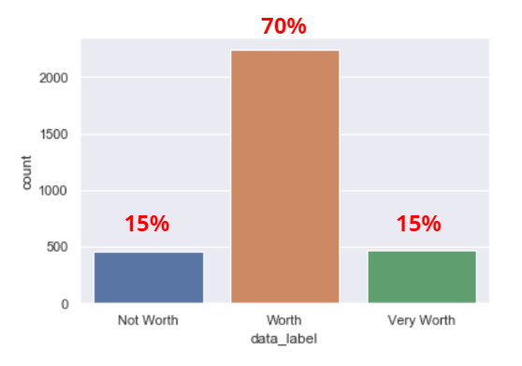
Model Selection
Model 1: Classification Decision Tree
Model 2: Logistic Regression
Model 3: K-Nearest-Neighbour
Extra Model: Feed-forward Neural Network
Model 4: Gradient-boosted decision tree
F1 Score: weighted average of Precision and Recall.

Slide 26
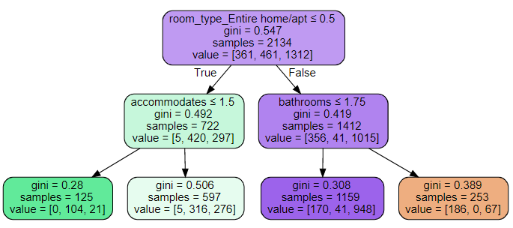
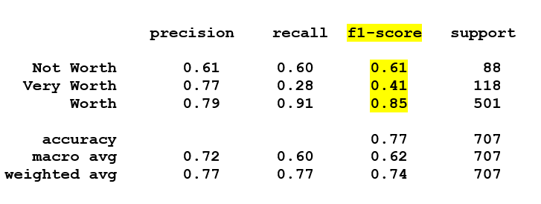
Classification Decision Tree Model

Slide 27
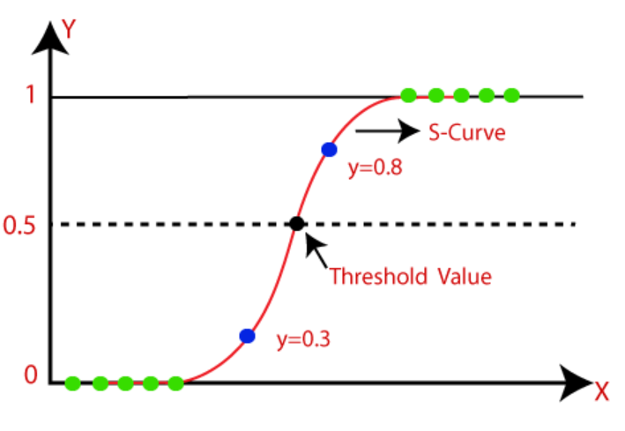
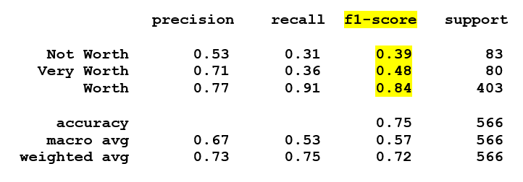
Logistic Regression

Slide 28
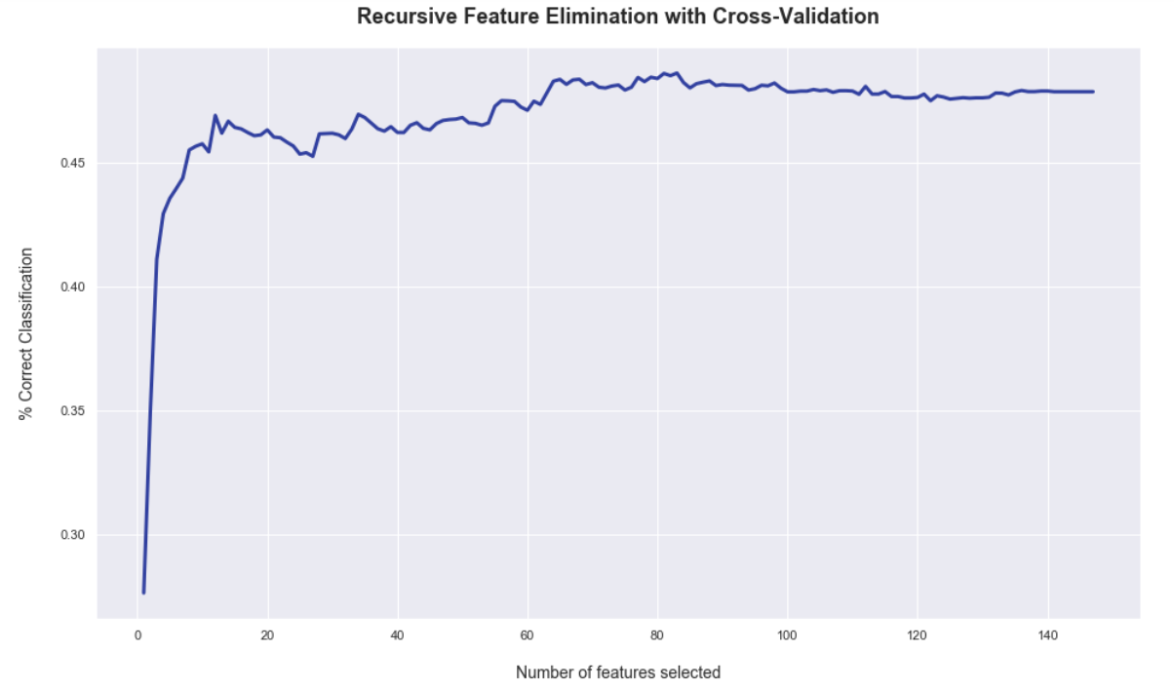
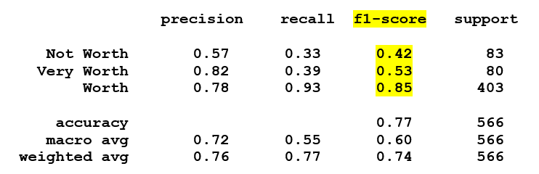
Recursive Feature Elimination with Cross Validation
Optimal number of features

Slide 29
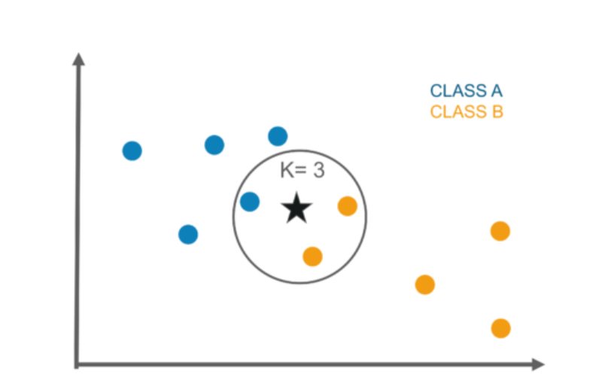
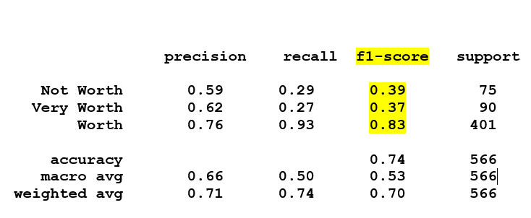
K-Nearest-Neighbour + GridsearchCV

Slide 30
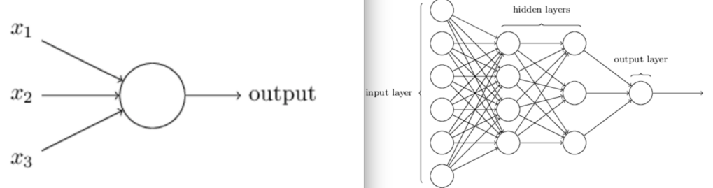

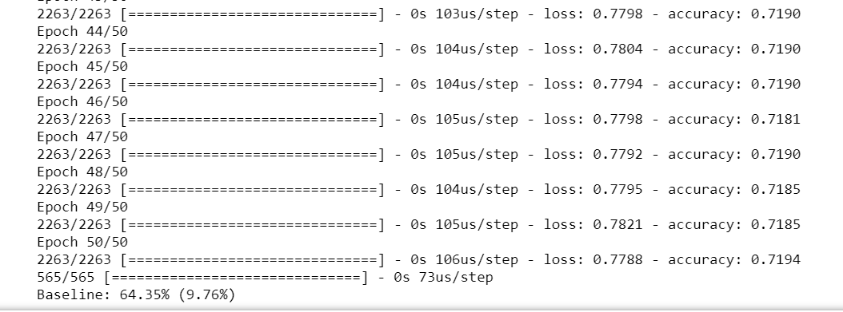
Feed-forward Neural Network
Notes:
Moving also tried deep learning, however as it is typically meant for huge amounts of unordered data, we didn’t have high expectations even if this is a state of the art model. We have input layer, hidden layers which can be more than one and output layer. The information in the model flows in the forward direction, for an example x is used to calculate some intermediate function in the hidden layer which in turn is used to calculate y.
And as expected, the accuracy score is very low due to our small structured data.

Slide 31
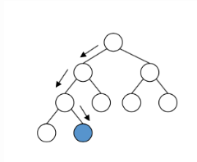
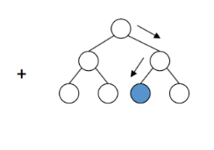
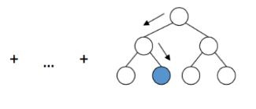
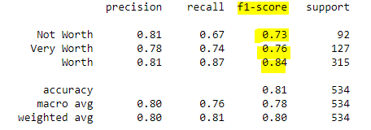
Catboost (Gradient-boosting decision tree)

Slide 32
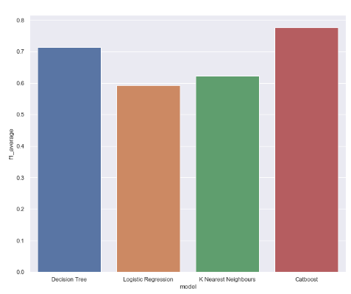
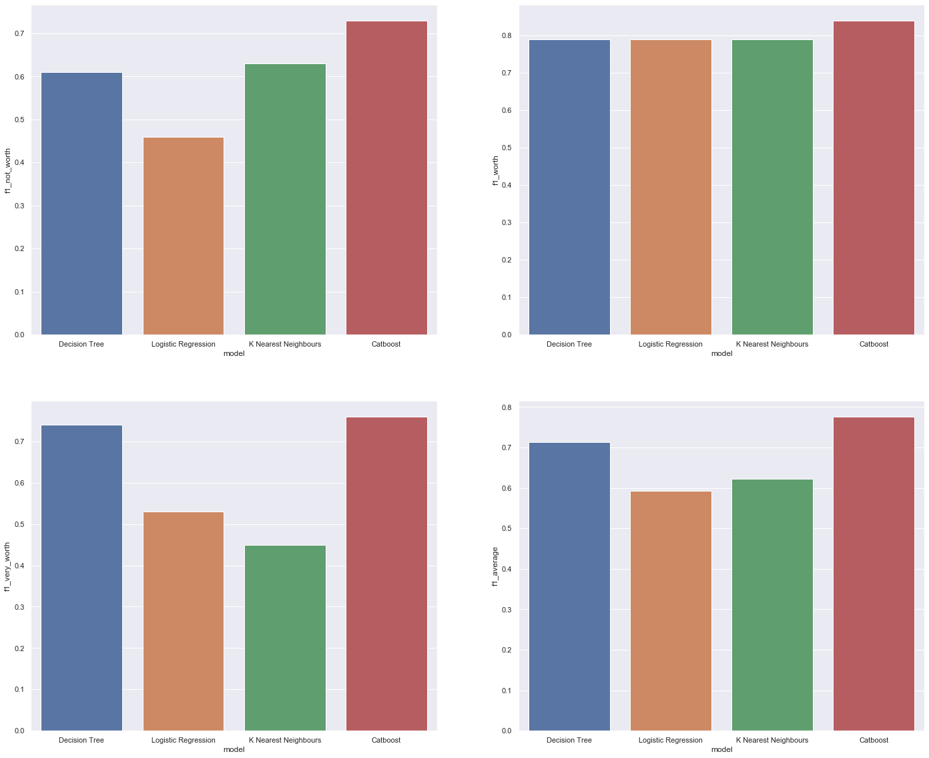
Model Evaluation

Slide 33
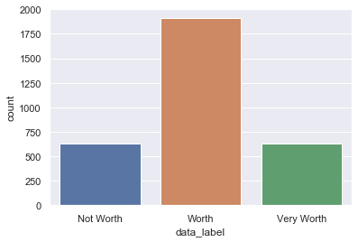
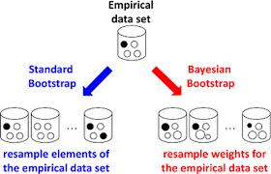
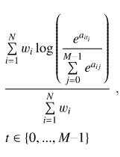
Imbalanced Classes
Bayesian Bootstrap
MultiClass Loss Function

Slide 34


Model Performance
Classification Accuracy?
1.Recall
F1 Score
2.Precision

Slide 35
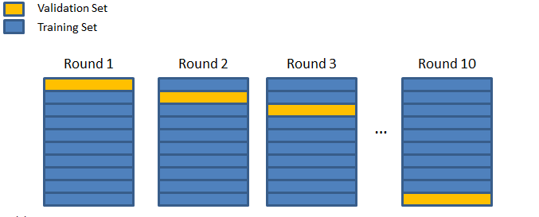
Overfitting
K-fold Cross Validation
Early-Stopping

Slide 36
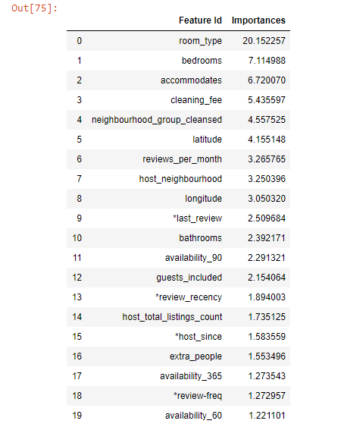
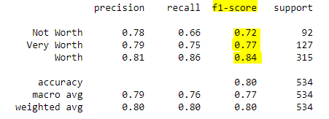
Model 2 (Cleaned Catboost)

Slide 37
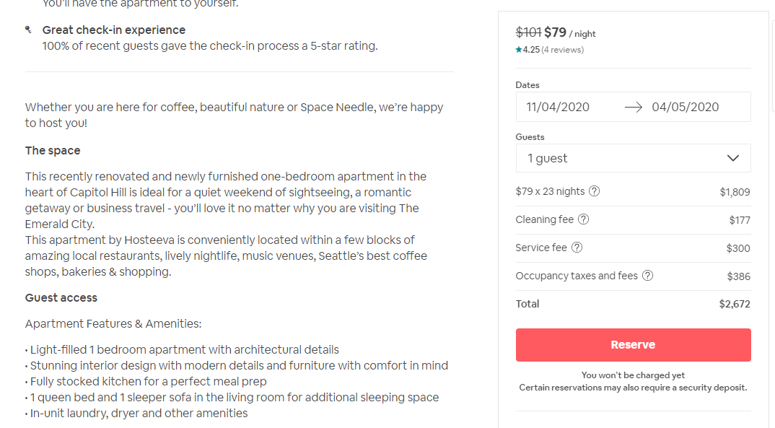

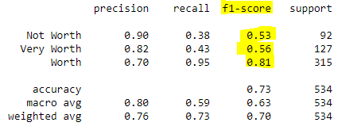
Model 3 (Pure NLP)
Bag of Words

Slide 38
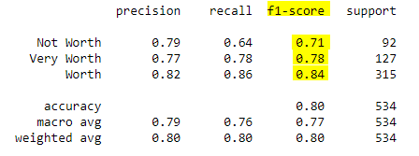
Model 4 (Mixed)

Slide 39




Feature Extraction
Model 1
Model 2
Model 3
Model 4

Slide 40

New Features

Slide 41

Final Model

Slide 42


Evaluation

Slide 43
What we learnt
Statistics: Bayesian Bootstrap, F1-Score
Visualisation: Tableau, Plotly, Seaborn, Matplotlib
Data Wrangling: Median-Imputation, One-hot encoding, Feature-Crossing
Machine Learning: GB Trees, Recursive Feature Elimination, Deep learning
Machine Learning Tools: sklearn, keras, catboost
Techniques: k-fold CV, NLP, GridsearchCV

Slide 44
Individual Contributions
Ian: Plotly & Seaborn visualisations, Data Processing
Jovan: Decision Tree, Plotly visualisations, Problem Formulation
Ray: Logistic Regression, K nearest-neighbours, Neural Network
Marcus: NLP, Neural Network, Catboost, Tableau Dashboard

Slide 45
Conclusion
Model performance > High likelihood that we missed out other important features
Study done by Carnegie Mellon University concluded that high quality images increased annual revenue by ~ $2000
Did not include sentiment analysis from text reviews
NLP data was too small
Reviews were skewed positively
Extracted sufficient information to inform consumers of things to look out for other than price/ reviews

Slide 46
THANK YOU!

